Slide 1
Random effects meta-analysis
Georgia Salanti
Notes:
Add castle
Remove historical example
Update steps - PICO

Slide 2
Fixed-effect inverse-variance-weighted average (1)
Require from each of k studies:
estimate of treatment effect, y_{i}
estimate of variance of estimate, v_{i}
(When using ratio measures, natural log of the ratio is used)
Combine the estimates using a weighted average
Take weight = inverse variance:
w_{i} = 1 / v_{i}
It is intuitively sensible to give more weight to the bigger studies

Slide 3
Application to risk ratios
From each trial:
Log risk ratio
Variance of log risk ratio ≈
Weight

Slide 4
Application to Roumen 2008
From each trial:
Log risk ratio
Variance of log risk ratio ≈
Weight

Slide 5
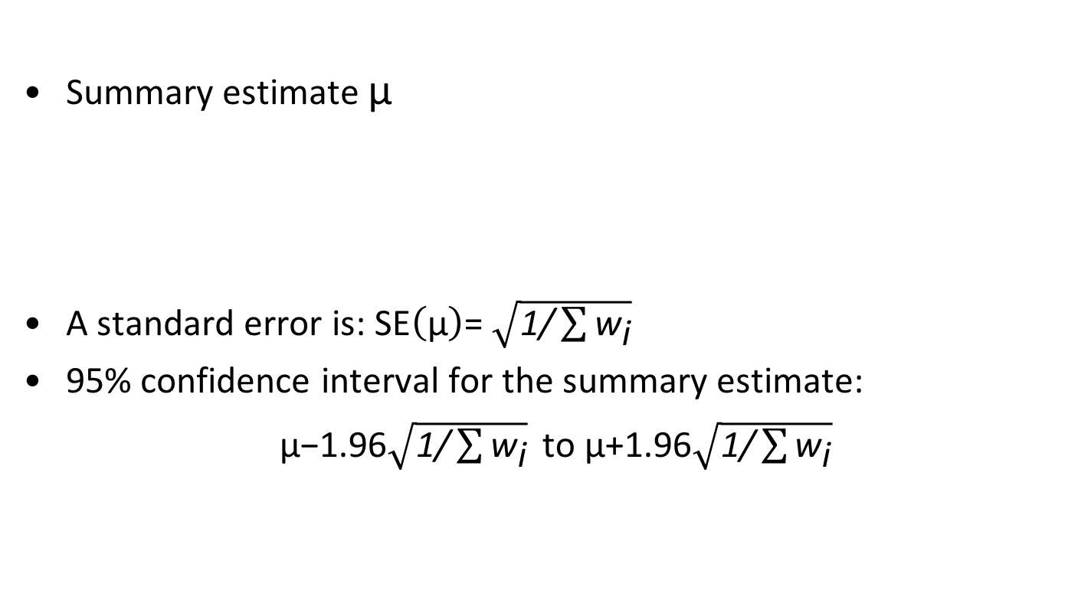
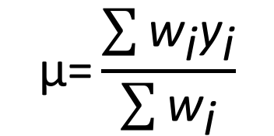
Fixed-effect inverse-variance-weighted average
Summary estimate μ
A standard error is: $\text{SE}\left(\text{μ}\right)\text{=}$ $\sqrt{\text{1/}\sum{{\text{w}}_{\text{i}}}}$
95% confidence interval for the summary estimate:
$\text{μ}\text{−1.96}\sqrt{\text{1/}\sum{{\text{w}}_{\text{i}}}} \text{to} \text{μ}\text{+}\text{1.96}\sqrt{\text{1/}\sum{{\text{w}}_{\text{i}}}}$
$$\text{μ}\text{=}\frac{\sum{{\text{w}}_{\text{i}}{\text{y}}_{\text{i}}}}{\sum{{\text{w}}_{\text{i}}}}$$
y_{i} can be anything! logOR, logRR, RD, logHR, mean difference, standardised mean difference etc.

Slide 6
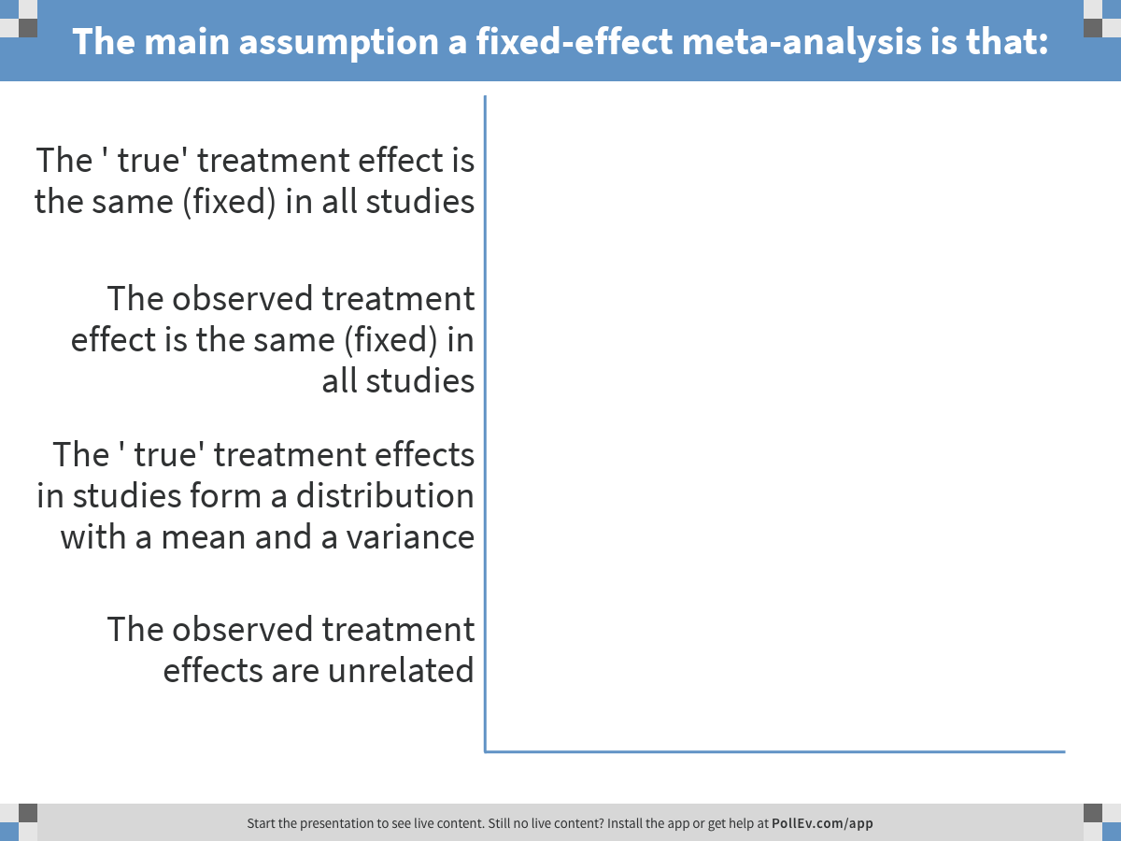
Notes:
The main assumption a fixed-effect meta-analysis is that:
https://www.polleverywhere.com/multiple_choice_polls/vrKII08MOACIkr8

Slide 7
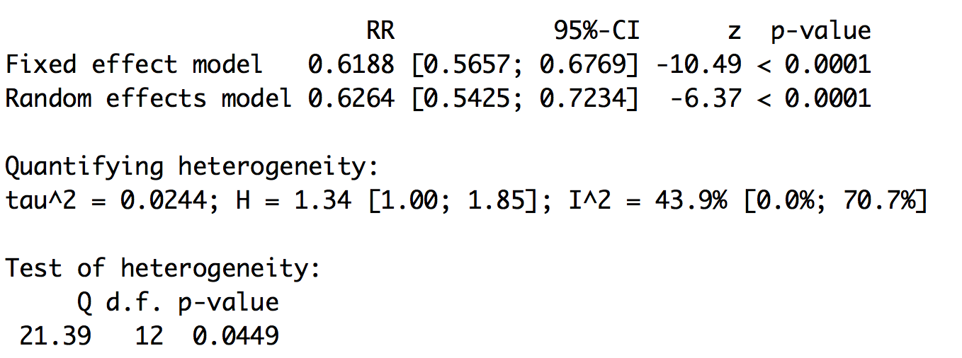
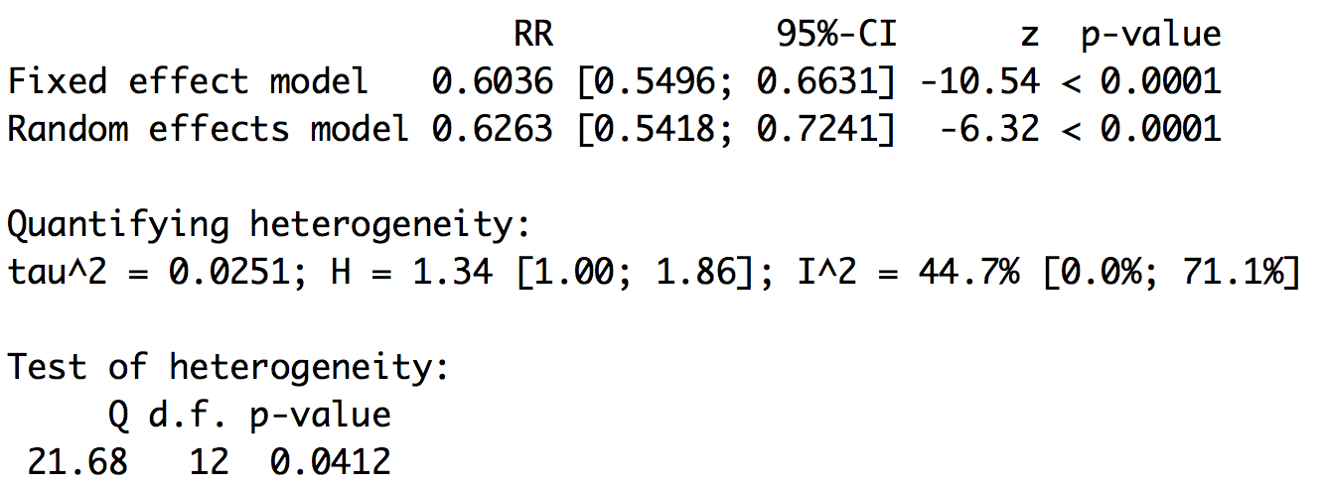
in R: poolRR<-metabin(r1,n1,r2,n2,studlab=Study,sm="RR”, method=”I”) summary(poolRR)
Fixed-effect inverse-variance
Study | r1 | n1 | r2 | n2
Kosaka 2005 | 3 | 102 | 32 | 356
Eriksson 1991 | 17 | 181 | 16 | 79
Tuomilehto 2001 | 27 | 265 | 59 | 257
Mantel-Haenszel
Notes:
Explain output:
Pooled est is summary OR, with CI.
Q: how would you interpret the Fixed-effect summary odds ratio? The p-value?
(P=0.000 interpret as <0.001.)
Now do the results look consistent?
(much easier to see they’re not than it was from the numbers alone)
Graphical display of individual study estimates and summary estimate in Forest plot:
Logarithmic scale used, so 0.5 and 2 are equidistant from 1. (Also CIs symmetric around point estimate.)
The diamond (and broken vertical line) represents the overall summary estimate, with confidence interval given by its width
Unbroken vertical line is at the null value (1)
Box area is proportional to the weight for the individual study. This ensures that studies with larger weights have bigger visual impact.
(next slide hidden as just gives above).

Slide 8
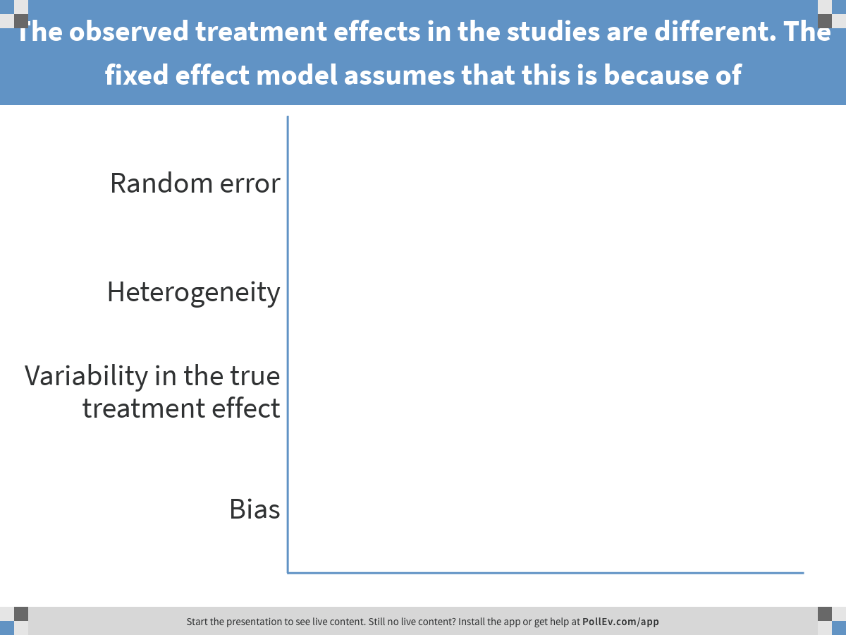
Notes:
The observed treatment effects in the studies are different. The fixed effect model assumes that this is because of
https://www.polleverywhere.com/multiple_choice_polls/8waWnW0M02HtkFG

Slide 9
Interpretation of fixed-effect meta-analysis results
assume all studies share an identical true treatment effect
estimate this single treatment effect
Mean treatment effect, μ
Random error
Effect estimate
Treatment effect

Slide 10
Interpretation of fixed-effect meta-analysis results
The confidence interval for the summary odds ratio reflects within-study errors only
Variation across studies (heterogeneity) is ignored
So the following yield exactly the same result
Many of us feel uncomfortable about this
Effect size
Effect size

Slide 11
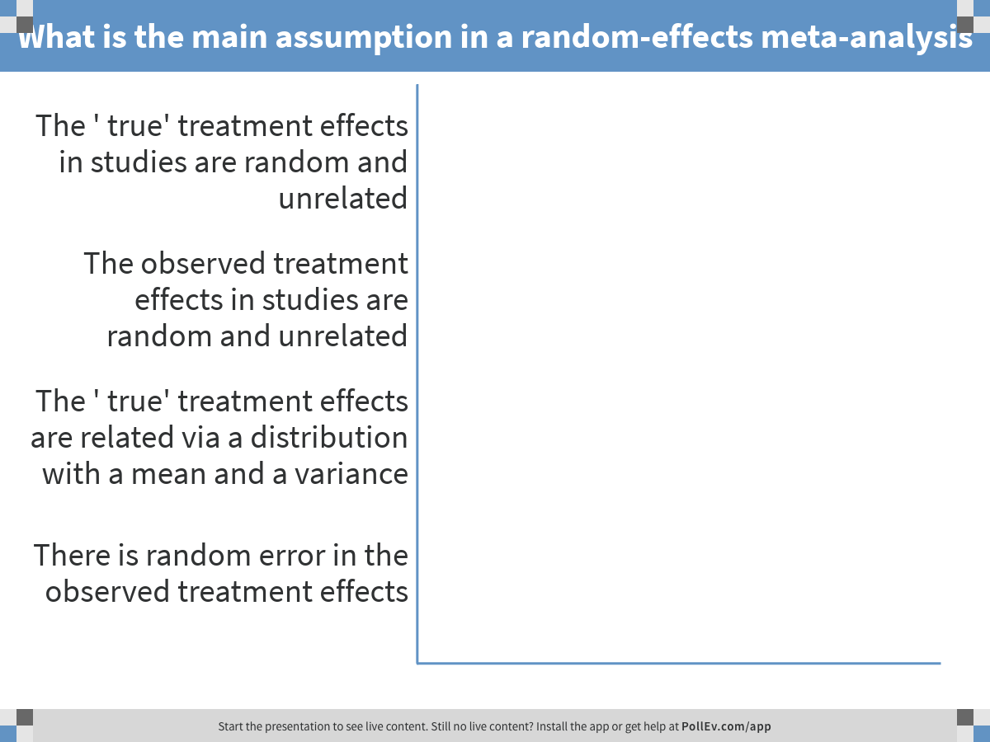
Notes:
What is the main assumption in a random-effects meta-analysis
https://www.polleverywhere.com/multiple_choice_polls/dI05mVR8lDNtTlD

Slide 12
Random-effects meta-analysis
Mean treatment effect, μ
Random error
Effect estimate
τ²
Treatment effect

Slide 13
Random-effects meta-analysis
We suppose the true treatment effect in each study is randomly, normally distributed across studies
with variance τ² (“tau-squared”)
Estimate the between-study variance τ², and use this to modify the weights used to calculate the summary estimate
The most common estimate of τ² is called the DerSimonian and Laird estimate, or method of moments estimate
but other (better) estimators are available
Effect size
Notes:
The true treatment effects for the individual studies are assumed to vary around some overall average treatment effect. Usually assumed to have a Normal distribution. Then estimate the mean treatment effect as the mean of this distribution. (Draw normal dist on board / flipchart and indicate tau)
To do this, and to get the right CI, need to first estimate the variance of the Normal distribution.
Simplest and most commonly used estimate is due to Rachel DerSimonian and Nan Laird (1986) a.k.a. ‘method of moments’. Formula is still a bit off-putting so won’t show it here!

Slide 14
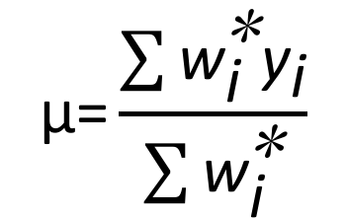
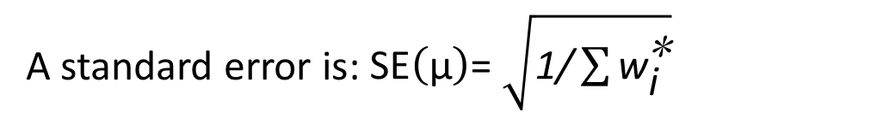
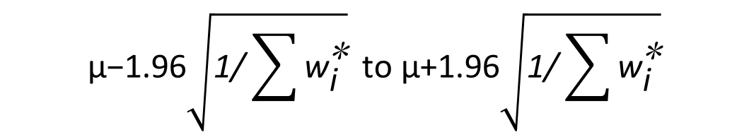
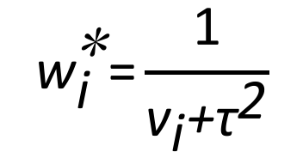
Random-effects meta-analysis (3)
$$\text{μ}\text{=}\frac{\sum{{\text{w}}_{\text{i}}^{\text{∗}}{\text{y}}_{\text{i}}}}{\sum{{\text{w}}_{\text{i}}^{\text{∗}}}}$$
Random-effects estimate:
$${\text{w}}_{\text{i}}^{\text{∗}}\text{=}\frac{\text{1}}{{\text{v}}_{\text{i}}\text{+}{\text{τ}}^{\text{2}}}$$
where
A standard error is: $\text{SE}\left(\text{μ}\right)\text{=}$ $\sqrt{\text{1/}\sum{{\text{w}}_{\text{i}}^{\text{∗}}}}$
95% confidence interval for the summary estimate:
$$\text{μ}\text{−1.96}\sqrt{\text{1/}\sum{{\text{w}}_{\text{i}}^{\text{∗}}}} \text{to} \text{μ}\text{+}\text{1.96}\sqrt{\text{1/}\sum{{\text{w}}_{\text{i}}^{\text{∗}}}}$$
Notes:
Formulae for R-E:
Summary estimate and variance formulae take the same form, except with different weights (w*).
Now add the estimated between-study variance tau-squared to the within-study variance v before taking the reciprocal.
Q: what is going to happen to the weights if we add the same amount to the denominator of all of them?
(all weights are smaller, so variance of summary OR is bigger.
Hard: weights are also made more similar to each other, i.e. studies weighted more equally.)

Slide 15
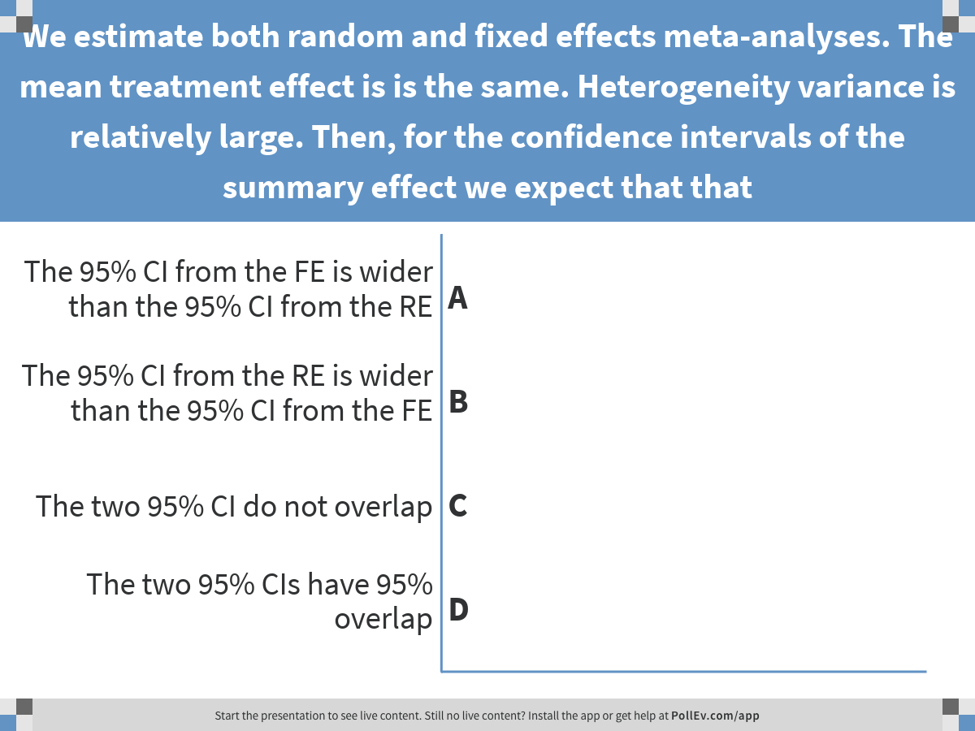
Notes:
We estimate both random and fixed effects meta-analyses. The mean treatment effect is is the same. Heterogeneity variance is relatively large. Then, for the confidence intervals of the summary effect we expect that that
https://www.polleverywhere.com/multiple_choice_polls/vrUrEyRBiCvhdWX

Slide 16
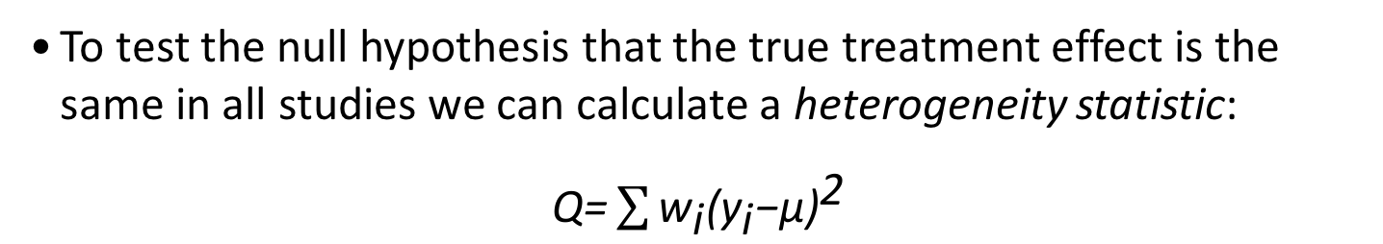
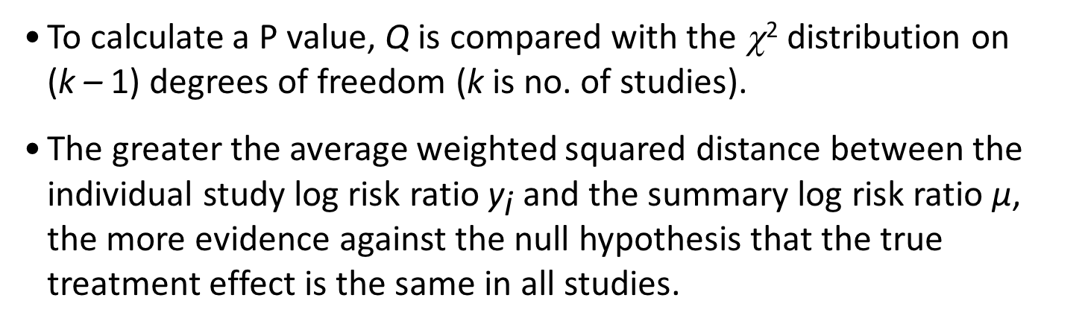
Identifying heterogeneity : test
To test the null hypothesis that the true treatment effect is the same in all studies we can calculate a heterogeneity statistic:
$\text{Q}\text{=}\sum{{\text{w}}_{\text{i}}{{\text{(}\text{y}}_{\text{i}}\text{−}\text{μ}\text{)}}^{\text{2}}}$
To calculate a P value, Q is compared with the χ² distribution on (k – 1) degrees of freedom (k is no. of studies).
The greater the average weighted squared distance between the individual study log risk ratio ${\text{y}}_{\text{i}}$ and the summary log risk ratio $\text{μ}$, the more evidence against the null hypothesis that the true treatment effect is the same in all studies.
Notes:
16
F-E methods most commonly interpreted as assuming that the true effect of treatment is the same in each study, i.e. fixed, the differences between study results being solely due to chance.
Can check this assumption with a statistical test for heterogeneity/(of homogeneity).
Q is a weighted sum of squares – squares of the difference between the study estimate and the summary estimate. Weights are the ones used before in calculating summary estimate.
H0 is that true effect is the same in all studies.

Slide 17
Identifying heterogeneity: τ²
The between-studies variance, τ² is estimated as part of the random-effects meta-analysis
It provides a useful measure of the true extent of heterogeneity across studies
Methods to estimate τ²
DerSimonian and Laird estimator is default; method.tau="DL”
Paule-Mandel;method.tau="PM"(Paule and Mandel,1982)
Restrictedmaximum-likelihood;method.tau="REML" (Viechtbauer, 2005)
Simulations and empirical analyses suggest that for both dichotomous and continuous data PM and for continuous data REML are better alternatives (Veroniki et al., Res Synth Meth 2015)

Slide 18
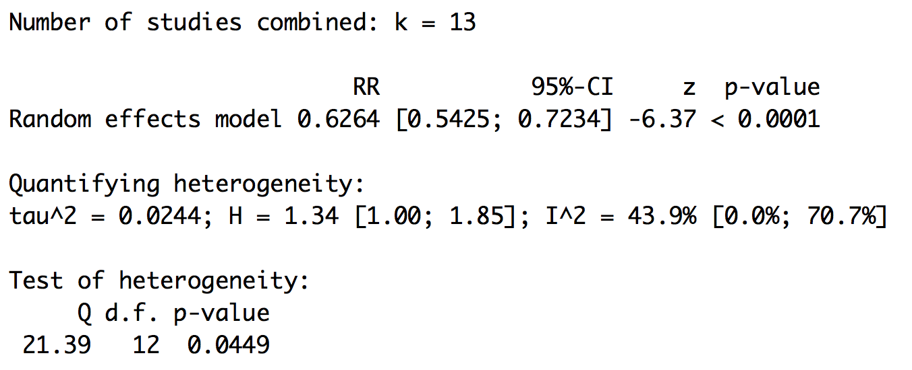
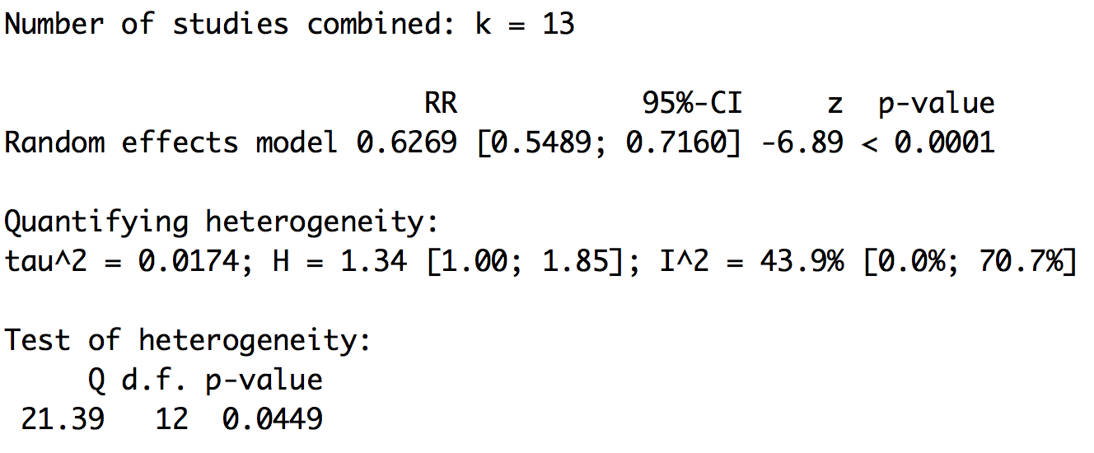
Example: Compare estimators of τ²
Inverse variance RE method
DerSimonian and Laird
Paule-Mandel

Slide 19
Fixed versus random effects: Identical results
Estimates with 95% confidence intervals
Kennedy 1997
Early light reduction for preventing retinopathy of prematurity
Locke 1952A
Lopes 1997
Reynolds 1998
Seiberth 1994
Fixed effect
Random effects
0.2
1.0
5
Risk ratio
Favours LR
Favours control

Slide 20
Fixed versus random effects: Slightly different results
Estimates with 95% confidence intervals
Trial
Woodcock 1981
Woodcock 1982
Opioids for breathlessness
Johnson
Eiser (A)
Eiser (B)
Bruera
Light
Chua
Poole
Davis
Leung
Noseda
Fixed effect
–0.32 ( –0.43 , –0.20 )
Random effects
–0.31 ( –0.50 , –0.13 )
-2
-1
0
1
2
Standardised mean difference
Opioid better
Placebo better

Slide 21
Fixed versus random effects: Very different results
Estimates with 95% confidence intervals
Study
Morton
Rasmussen
Smith
IV magnesium for acute MI (mortality)
Abraham
Feldstedt
Shechter 1990
Ceremuzynski
LIMIT-2
Bertschat
Singh
Pereira
Golf
Thogersen
Shechter 1995
ISIS-4
MAGIC
Fixed effect
1.01 (0.97,1.07)
Random effects
0.76 (0.62,0.92)
0.01
0.1
1
10
Risk ratio

Slide 22
Add random-effects prediction interval
forest(poolRR, prediction=T)

Slide 23
Prediction intervals
Prediction intervals portray the actual heterogeneity across studies
An interval within which the true effect size in a similar study (from the same distribution) is predicted to lie
$$\text{μ}\text{−}{\text{t}}_{\text{k}\text{−1,0.025}} \sqrt{{\text{SE}\text{(}\text{μ}\text{)}}^{2}+τ^{2}} \text{to} \text{μ}\text{+}{\text{t}}_{\text{k}\text{−1,0.}\text{97}\text{5}}\sqrt{{\text{SE}\text{(}\text{μ}\text{)}}^{2}+τ^{2}}$$

Slide 24
This is a generic approach
Suppose we have an estimate of some quantity, y_{i}, and we know its variance, v_{i}
Then we can perform a meta-analysis as a weighted average
FE:
RE:
For example, for binary data, y_{i} could be a log odds ratio or a risk difference
we (almost) always work on the log scale for ratio measures
Note: these methods ignore uncertainty in τ²

